Slide 1
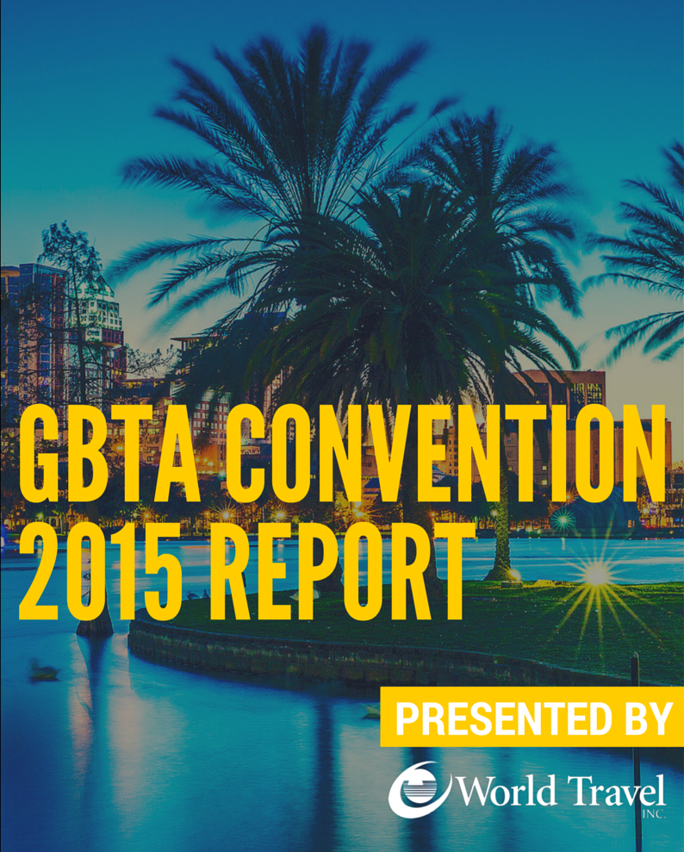

Slide 2
Table of Contents
3 Why Attend GBTA?
4 Expert Interview: The Future of Airline Competition
6 Panel Discussion: Differentiating Brands in a Sharing Economy
8 Education Sessions
First Education Session
Second Education Session
9 BONUS Education Session: Creating a Practical Travel Risk Plan
12 BONUS Education Session Notes: Ask the Experts: Global Travel Management Challenges Featuring: Maureen Brady from World Travel, Inc.
15 Keynote Speaker: Kevin Bacon Golden Globe® winning Actor, Producer, Director, Musician
16 Expo Floor Notes
17 Panel Discussion: The Future of the Travel Distribution Landscape
18 Panel Discussion: Ground Transportation in a Sharing Economy
20 Education Sessions
Third Education Session
Fourth Education Session 21 BONUS Education Session: #Sharing 101 - Actionable Guidance for Corporate Travel Managers
23 Keynote Speaker: Steve Wozniak A Silicon Valley Icon and Philanthropist
24 Education Sessions
Fifth Education Session
25 Keynote Speaker: Megyn Kelly Anchor of FOX News Channel's (FNC) The Kelly File
26 Coming Soon from World Travel, Inc.
Monday
Tuesday
Wednesday

Slide 3
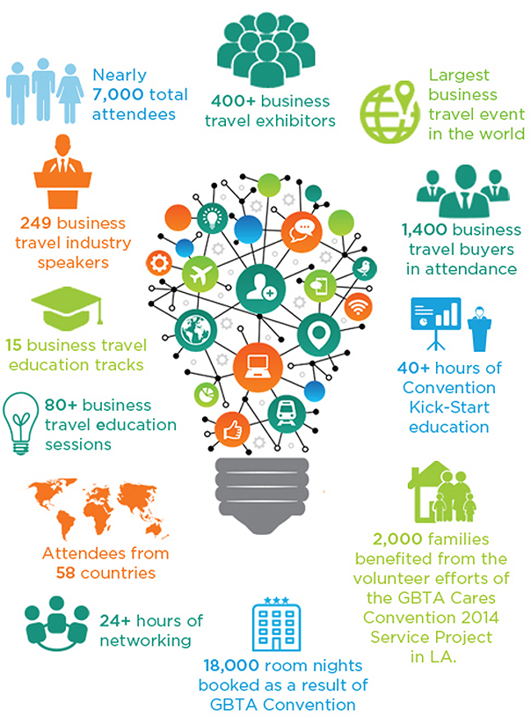
Why go?
Who knows why to attend GBTA conventions better than GBTA? Here’s what the Global Business Travel Association has to say about the benefits of attending the GBTA Convention.
It saves your company money:
Save on travel expenses by meeting with suppliers in one place; identify new techniques, processes, products, and services that could improve your bottom line
It offers you unparalleled learning opportunities:
Choose from 75+ educational sessions brought to you by GBTA Academy, hear from admired industry experts, CEOs, and global thought leaders
It brings you 400+ suppliers under one roof:
Meet with your existing suppliers and check out the market’s newest offerings on the expo floor
It accelerates your professional development:
Take advantage of professional power- Up programming and sit for your GTP certification, or register for one of the many advanced courses that Gat Academy will offer
Benchmark your program against others in the industry:
Refine your travel program by swapping ideas to identify best practices and reduce risk
3

Slide 4
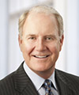
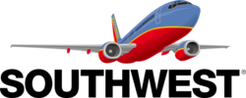
Future of Airline Competition Panel
Interviewer
Charisse Jones
Business Travel Correspondent
USA Today
James Hogan President and CEO
Etihad Airways
Gary C. Kelly Chairman of the Board, President & CEO
Southwest Airlines
The 2015 GBTA Convention started with a sit-down discussion with the leaders of two of the airline industry’s most groundbreaking and innovative companies. Although Etihad and Southwest offer very different products, they are tuned into the nature of service and what it means to provide the very best.
Mavericks
Cherisse Jones began her interview with Gary C. Kelly by asking about the U.S. Justice Department’s investigation into the major U.S. Airlines after accusations that they are limiting the number of available seats in order to increase prices, a violation of antitrust laws. With a solid assurance that Southwest will comply with all civil investigative demands, Kelly pivots to the success of Southwest.
“We’re growing. We’ve been transforming Southwest over the past five years so that we could grow.” Siting 7% growth year over year, he credits that success to the distinctive brand. “We’ve always been a maverick. We’ve always been different.” Indeed, you have to work harder for your product not to be simply another commodity.
The Southwest Effect
We call it “The Southwest Effect”, the impact Southwest’s low fares have on prices when a low-cost carrier is introduced into a legacy-heavy market. And it still exists. “In 90% of the cities we serve, Southwest has the lowest fare.”
No Bag Fee. Still.
With Southwest, enjoy no bag fees, no change fees, and no plans to begin charging for either. While the biggest U.S. carriers made 864 million dollars from bag fees last year, a full 2.2% of total operating revenue, Southwest believes the marketing advantage is still in their favor. “We want to offer a product to customers that they’re proud of. We want to be as simple, and straightforward, and pleasant to do business with as possible.” Kelly estimates that if they traded on this public promise and opted in to bag fees, the airline would lose a billion dollars net profit. As for other airlines charging to stow your luggage? “I think it’s a gift. I love our competitors for it!”
10 International Destinations, and Growing
What’s next for LUV? Expansion. Those single-cabin configurations will be spreading across the globe in the next few years. Southwest is currently building an international terminal in FLL and investing in opportunities around the country, “so that we can grow.” They’ll stick with flying the Boeing 737, while stretching that international footprint. But Kelly ends with a promise: No bag fees. No change fees. Just serving more places with more customers.”
Monday
4

Slide 5
Future of Airline Competition Panel
Open Skies are Not-So-Friendly
When Jones addressed James Hogan, President and CEO of Etihad Airways, she started with a bang, asking about the dispute over Open Skies with the U.S. legacy carriers, United, American, and Delta, and rumors of government subsidies for the Gulf carriers.
“We comply to all government regulations. We’ve released all documents to the government.” Frankly stating that Etihad is in full compliance, Hogan jokes about the free publicity. “If you didn’t know who we were before…”
Feeding the Network
Etihad Airways has a different set-up than other giant Gulf carriers. “We have the Middle East and the Indian subcontinent. This is a region that is close to the population of China. When you look at our position and ask if there is enough traffic for three carriers, the answer is: there is.” As the smallest airline of the bunch, Etihad has a different strategy. “We are very focused on how we knit the network. We codeshare with over 30 carriers and partners from around the world. We have segmentation.”
With over 140 different nationalities in the airline, the Etihad model focuses on service, respect for the customer, and innovation through technology and working with partners. “We connect America to parts of the world where U.S. carriers don’t operate.”
Synergy Set-Up
There are various airlines within the Etihad family, and Hogan supplies that they carefully examine the integration of the network. “We look at the flying and how we feed each other. From a competition perspective, obviously, in each of the markets we have synergies. We’re in fact the 5th largest aviation entity in the world. As a group, we leverage our size for financing, a fact that makes us different as an airline over other gulf carriers.
New Meaning for High Service
Etihad offers high-touch service ─ chauffeurs, in-air showers, turn-down service. “One of the great things about travel in this industry is that you know who your client is. We don’t have passengers; we have guests.” Siting the variety of clientele ─ religious traffic, ethnic traffic, business traffic, etc. ─ Hogan knows it’s important to communicate with the client and innovate new and better ways to provide service. “The space on the front of the aircraft was dead space; you couldn’t put seats in there. How do you look at that space and create innovation? Chefs, butlers, nannies on board (we give your children back!)… the key here is from a revenue point of view.”
Monday
The Takeaway
To stay ahead of the pack, airlines shouldn’t feel pressured by the rest of the industry.
The Middle East is not a monolith, and not all the Gulf Carriers are the same.
Learn how different operational networks interact with your travel program.
5

Slide 6
Differentiating Brands in a Sharing Economy Panel
Addressing the latest game changer to the market, the panel sat down to discuss the Sharing Economy model, and how it will affect travel.
What is the Sharing Economy?
Stubblefield: The “Share Economy” has been around for a long time. On any given week we share more than 1 million vehicles here in North America. Customers want access and convenience. They want low cost. And they want to have full information on the commodity they’re using. Consumers are changing their habits. They want it when they want it where they want it and how they want it.
Pérez Fernández: “Share Economy” is a contradiction in terms. “Share” doesn’t mean you can ask for a price. Perez Fernandez brings up a major issue that traditional suppliers have with the share economy newcomers: We would be collecting 8 million euros in taxes if the share economy was regulated.
Ceille: We think of this more in terms of efficiency. The average North American car sits idle for 23 hours a day. The purpose of Zipcar is to make the world more efficient in terms of time and money; members have access to 15 million vehicles.
Conley: We’re sharing the world’s resources through technology. With Airbnb, someone traveling for two weeks can be a host and a guest at the same time.
How is “Sharing” Different for Corporate vs. Leisure Travel
Ceille: The Sharing Economy changes the very notion of travel when it comes to car ownership. People who live in urban or crowded areas use membership to access cars. But 25% of users are business or corporate members who use it Zipcar for transportation, to augment or replace fleet vehicles, or to reduce their impact on the ecosystem.
If necessity is the mother of invention, Airbnb was created for the “bleisure” traveler.
Conley: The reality is: this isn’t corporate versus leisure or hotels versus homes. People are looking for discovery more than indulgence. The average length of stay for a business traveler is 6.5 days.
However, the continuity of traditional business suppliers can be a benefit.
Stubblefield: We offer consistent access to our product across the globe. If you want a problem taken care of, it can be taken care of right away. And it’s the same thing everywhere you travel. We’re in a unique position because of our footprint; we’re able to scale that across the globe.
Pérez Fernández: It’s about consistency. There have always been blurred lines between corporate and leisure.
Moderator
Guy Langford Vice Chairman, US THL Leader Deloitte & Touche LLP
Monday
Kaye Ceille
President
Zipcar
Chip Conley Head of Global Hospitality & Strategy Airbnb
6

Slide 7
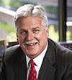
Differentiating Brands in a Sharing Economy Panel
How Important is Technology?
Conley: At Airbnb, we are a technology company. We’re also a design company. The combination has created one of the most valuable companies in the industry. There are 60,000 Airbnb homes or apartments in Paris alone. And as a tech and design company that evolves, the more we get to know you, we can refine your offering.
Ceille: Zipcar is a technology company, and a product-driven company. Our tech allows for self-service: gain access to the car, the car unlocks automatically, manage the reservation process, and allow our members to communicate back and forth with us. Technology is integral to everything we need.
Pérez Fernández: In response to being referred to as a “traditional” company: Traditional Company? That sounds not very good…. At the end of the day, we focus on innovation. Innovation sells experience. If you’re not doing something that enhances experience, it doesn’t matter.
Stubblefield: We invest in technology to support what our customers need. We are a customer satisfaction company; technology enables us to support customer satisfaction.
Disruption: Is The Sharing Economy a Game Changer for Corporate Travel?
Conley: We weren’t business-focused until about a year ago. Now corporate travelers can look at a dashboard and see where their travelers are all around the world. Disruption is a good thing.
Ceille: We’ve disrupted car-ownership most of all, and now that’s bleeding into the corporate travel. The evolution of our technology keeps us ahead.
Pérez Fernández: We’ve embraced disruption. We love to be challenged, to improve the experience of our customer.
Stubblefield: We’re a bricks-and-mortar model that has augmented our process with technology, but provides traditional experience as well. As long as there’s a level playing field when it comes to public policy, taxation, and regulation, we’re happy to compete.
Gregory R. Stubblefield Chief Strategy Officer & EVP Global Sales & Marketing Enterprise Holdings
Monday
Rufino Pérez Fernández Chief Commercial Officer NH Hotel Group
The Takeaway:
Sharing is a misnomer. This market phenomenon is about access, convenience, and cost savings.
“Bleisure” is a thing now. You’ll need to start thinking about creating policy around it.
Consider your needs: Is eco-impact important? Is consistent service important?
Tech company or “traditional” company? Consider the benefits of each for your program.
We have to embrace disruptions. At the end of the day, the winner will be the consumer.
7

Slide 8
Over 80 elective education sessions were offered over the course of the week, allowing attendees to explore specific topics within the travel industry.
First Education Session Notes:
Click inside this text box and insert any notes you took on your first education session.
Monday
Second Education Session Notes:
Click inside this text box and insert any notes you took on your second education session.
Workshop 2 Notes:
8

Slide 9
Creating a Practical Travel Risk Plan Presented by the GBTA Risk Committee
Shelby LeMaire, Corporate Travel Manager, iRobot
Erin Will, SVP Global Corporate Security, Global Travel Safety Program Manager, Bank of America
Mark Donohue, VP Risk Management Services, iJet International
Matthew Bradley, Regional Security Director, Americas, International SOS
Kathy Bedell, SVP, BCD Travel
This education session was intended to show attendees what a formal Travel Risk Management Program looks like, why it matters, and why travel managers should care. Shelby LeMaire, Corporate Travel Manager of iRobot, shared a very detailed and structured look at what it takes to develop and maintain a comprehensive and cohesive Travel Risk Management Program, illustrating that an engaged TMC, and engaged C-Suite, and an engaged traveler base are all crucial.
LeMaire began with a definition: Duty of Care is the responsibility or the legal obligation of a person or organization to avoid acts or omissions which can be reasonably foreseen to cause harm to others.
“There are laws and legislation that require companies to take care of our travelers. We comply with Duty of Care laws through an effect TRM program.”
Primary Elements of a Travel Risk Management Program
Travel Related Risk
Once you begin to think about it, the risks associated with travel compound exponentially. Travel risk is about more than just flight safety. It encompasses medical treatment, unsanitary food, crime and terrorism, natural disasters, automobile accidents, infectious diseases, and much more. The risks are even greater for the infrequent traveler because of their lack of experience in unfamiliar environments.
Why does all this matter? Beyond a moral obligation, LeMaire points out, “A catastrophic incident can impact growth, resources, and business continuity.” Preparation and foresight will cost less in output and resources than reactionary measures. LeMaire built the iRobot TRM Program from the ground up, developing a sustainable and evolving system based around the Four Ts: Treat, Transfer, Terminate, and Tolerate. These are the key points for mitigating risk. Within your company, every reservation must be designated with a destination risk rating. C-level involvement is required for extreme risk destinations, to consider if the risk is worth the benefit of travel. Every risk is mitigated the best way possible, beginning with education. Travelers are encouraged to reach out to medical and security suppliers to get a debriefing about the risks they face, recognizing that risks vary from country to country and destination to destination.
Monday
TRM Policy
Management Support
Responsible Employees
Systems/Tools to Manage Risk
TRM Supplier Network
9

Slide 10
Companies should review all insurance policies to ensure proper coverage. “A TRM safeguards employees and fulfills duty of care requirements. Additionally, it enforces a sense of morale that you’re looking out for your employees. And of course, it mitigates risk and reduces liability.”
TRM Team
It’s imperative to establish an internal TRM team who manages the day-to-day responsibilities and responds to any incident. Each team member should have defined roles and meet regularly. The ideal team is composed of a cross-section of company departments, for example: risk management or security, legal, HR, travel manager, and senior leadership.
Established Process
For iRobot, when every reservation is booked (before it is ticketed) the destination risk information is provided to the traveler via email. Employees must follow set policy directives to help mitigate risk and prepare them for travel. The pre-trip approval process requires two levels of approval and will go to C-Level when risk is extreme. Meanwhile, employee compliance with policy is verified. Only then is the reservation ticketed. “The traveler is on their way, and we know that we’ve done all we can to safeguard that employee.”
Elements of a Comprehensive TRM Program
There are multiple integrated parts to an effective TRM Program. LeMaire shared her outline of the iRobot TRM program elements in order to give attendees a clear view of the multiple considerations that must be made for effective travel risk management.
TRM Policy and Procedures - Your company should have a comprehensive TRM Policy. As an example, iRobot does not allow travelers to make any reservations outside World Travel, Inc., their designated TMC, in order to ensure traveler tracking data. Additionally, “We do not allow side-trips without pre-authorization. Our employees can’t just say, ‘Hey, it’s the weekend. I’m going to Hong Kong.’ It’s not that we don’t allow them to go; we just want the PNR to be documented so that in the event of an incident, we can find them.”
International Travel Destination Information - When a reservation is made, destination-specific information is emailed to the traveler. As LeMaire says, educated travelers are an essential component of an effective TRM Program. “This program is not to panic you. It’s to safeguard you and let your trip be more productive.” This means providing cultural information, document requirements, vaccine information, initial alerts, and ongoing alerts.
Medical Security Support - Contract with a medical and security provider that debriefs employees, answers questions, and can help employees in times of distress. LeMaire stresses that the contracted medical and security support provider should not just respond to emergencies, but be an engaged part of the traveler’s booking process.
Incident Response Procedures - Stay on top of your protocol. “You don’t want to be in a position as a company to be trying to figure out what to do during a crisis. The risk landscape is constantly changing. It is truly important as a company to engage in the ongoing cycle of evaluation for your program.” Traveler Tracking - A self-explanatory component of the equation, traveler tracking allows you to know where your employees are, and the best way to reach them.
TRM Program Training - “Be in front of your employees and train them on what they have available to them. It’s important for them to know that you have a program within your company that is protecting them.” LeMaire has a very non-cynical view of non-compliance. “We have travelers that oftentimes may not do the right thing. I feel that when I identify them, it’s more often because they are unaware of what they should be doing, not because they are knowingly avoiding policy.”
Employee Responsibility - The goal of training is to therefore ensure that employees are aware of what is required and ultimately act within compliance. “Knowledge is power for the employee. It’s important that they respect and understand what you’re trying to do for the company.”
Monday
10

Slide 11
Employee Compliance and Verification - Employees are required to fill out an online form, and LeMaire makes it clear to her travelers that the form is not intended to hinder the traveler; it’s to ensure that they have effective, safe travel. “As employees comply with your program, your risk as a company decreases.”
“Luck couldn’t and shouldn’t be a plan for the future.”
Pre-Deployment Focus - As LeMaire says, “The best plan in the world isn’t going anywhere if you can’t convince your C-Levels. The ROI is the relationship between the program’s cost and the savings it can generate through avoidance of cost.” These costs are more significant than you might think. “You are avoiding a reactive response, recovery, legal engagement, and low employee morale.”
As LeMaire reiterates in summation, establishing and maintaining an effective TRM Program is an imperative. “A significant travel incident is a threat to business continuity, business strength, and business growth. But implementing a TRM Program also comes out of the desire to do the right thing for your employees.”
The TMC Role
Your TMC works hand-in-hand with you and with the traveler to encourage engagement and compliance in your Travel Risk Management Program. They can also help you action your policy, create and manage your trip-approval processes, and provide invaluable access to travel data.
Medical and Security Supplier Insight
Mark Donohue from iJet International touched on the role of the medical and security support company. While incident response is reactive, planning, training, and 24/7 monitoring are all proactive TRM involvement. He encouraged attendees to “focus on proactive preparation, so that the need for reactive measures is less costly, less work and more efficient.” All travelers should get basic safety and security program training, but those traveling to higher risk arise will need more detailed training, even as far as hostage, survival, and kidnapping training. Most importantly, it’s important to provide a feedback loop for lessons learned that can be incorporated back into the program.
Matthew Bradley from International SOS also provided perspective on TRM scope. “All companies are either global, or going global. There’s no other way to look at it.” An effective TRM Policy allows you as a company to assess, advise, and assist your travelers. While a catastrophic natural disaster might not happen every day, providing something as simple as food and medical information to your travelers will help them avoid the stomach ache that makes them miss an important meeting.
And remember: “You have a legal obligation to make sure that your business is conducted safely.” Even if you don’t have a TRM program, in a court of law, if there’s a like-minded or like-sized company that does, that is the standard to which you will be held.”
So prepare today. Because risk happens and exists everywhere.
Want to learn more?
A special thanks to Shelby LeMaire, Corporate Travel Manager at iRobot, who generously provided much of the information above to GBTA attendees and agreed to let us re-print her notes for the benefit of World Travel, Inc. clients and friends. Shelby is an invaluable resource for travel managers looking to begin the Travel Risk Management Program process, and is happy to consult with professional colleagues to assist in this process.
Shelby LeMaire
Corporate Travel Manager, iRobot
781-430-3208 slemaire@irobot.com
Monday
11

Slide 12
Ask the Experts:
Global Travel Management Challenges
What’s the biggest challenge with going global? It depends on the maturity of your program, on your global footprint, and on your business strategy. It’s important to find the right fit for you.
Beginner Programs
Is my company ready to go global?
Gonzales: It’s important to determine the purpose of going global, knowing what you want to achieve from globalizing a travel program. And particularly: how you apply Duty of Care.
Warner: Go global to control spend and maximize value. The smaller the program, the less savings you should expect from globalization, but the transparency/governance and laws from a global point of view are their own ROI.
Brady: You globalize a travel program for governance and transparency. Especially if you’re beholden to investors! How is your money spent? You need transparency into how you’re spending your money. There’s no minimum spend for entry. Do you have any idea of what you’re spending on travel in any part of the world? If the answer is NO, that’s a reason to globalize.
Jones: The purposes of going global should reflect your business strategy. Integrating technology in a global program is also important. When it comes to travel, one of the first things that is underestimated purely from a technology standpoint is: where does your data sit? The Safe Harbor Act Agreement between the US and Europe is an attempt to standardize that. Localization, currencies, all come into play. What technology infrastructure do you have in place to manage currency in various markets in which you operate? You may need a set of technology partners to help facilitate your entry into a specific market. And you also must consider adoption. How do people travel? What are the tools and suppliers they favor? One major example is the difference in attitudes towards rail travel between the U.S. and Europe.
Which model is best?
Gonzales: This is a fundamental part of every program requirement. There’s the global model with a single TMC globally, the network model with multiple service providers, and the regional model that has hubs in certain parts of the globe. They all work. But do they work for your travelers and your organization?
Brady: At the end of the day, it’s about getting your people to be comfortable in joining the program. Are they going to resist or go outside the program because they don’t want to join? they need to book in the program in order to get the data. So what does that mean? Does it mean staying in the local market and using a provider that speaks the language? And remember, you’re only going to be able to find some local content within certain markets.
Warner: All three models can work, provided there is the right governance, and you have the right commitments and an SLA that supports the configuration. Make sure that technology, outcomes, and services are being deployed on a local basis. Then it’s a matter of access to rooms and rates. Travelers like to be the real experts. Take China as an example: People who are trying to book China from outside of China will end up booking significantly higher rates.
Monday
12

Slide 13
Ask the Experts:
Global Travel Management Challenges
Moderator
Rafael Gonzalez Head of Global Sales, Radius Travel
Maureen Brady
EVP Client & Consulting Services
World Travel, Inc.
Martin Warner Principal, MW Travel Consultancy
Cameron Jones
Chief Commercial Officer, SilverRail
Jones: There’s also a local content problem. Look at how the rail industry emerged. Back when they started, countries and rail lines were only self-concerned. You can see it in the fact that the rail gages were different from country to country. Aggregating the disparate data is now a concern.
Intermediate Programs
What has to be considered when capturing data?
Warner: Data should have high quality and high consistency. Keep it simple. Understand what is necessary to report on. Hierarchy is an example of where complexity comes in. What happens if someone moves departments or cost centers, or you reorganize your company structure? Also: Currency diversity requires forethought. You have to set up your consolidation currency, then deal with fluctuating exchange rates. Are you going to use a constant exchange rate, or compare current versus past? All this configuring comes at a cost, too. Do you want to pay a premium?
Brady: The big question is: how does data even become data? It starts with your service operations. One of the key differences about data is that in the United States, for the most part, your TMCs are issuing invoices from the GDS. Outside the US, that is not the case. So first, understand how the data becomes data. Tickets outside the U.S. have a different setup when generating data, usually out of the mid-office or back-office. You’ll find yourself saying, “I know the ticket got issued, so why isn’t the data in my report?” You have to understand how and when you get your data.
Jones: You also have to consider challenges from a supplier side of extracting the data. In the rail space, there aren’t any standards. No standard codes like IATA has for airports; no ARC. Each operation has its own standards. There are more train stations in the UK than there are airports in the whole world. Travel managers should be the owners of the structure of the data.
What are the Duty of Care considerations?
Gonzales: Who should be responsible? Which department owns this? And what constitutes an emergency? As an organization, this might vary from one company to the other.
Brady: I’m passionate about Duty of Care. This should be one of the main purposes for globalizing. American corporations have the liability to provide a safe environment for their employees, and that includes travelers. There’s a lot of case law around this. World Travel, Inc. recently did a survey that found that almost 30% of travel managers polled felt that their company didn’t have a Duty of Care policy. Meet with your HR or Risk Officer. Your corporation probably has policies, and this is a key undercurrent for getting your travel program going.
How do we navigate cultural differences?
Gonzales: It’s very important to be mindful of cultural differences, especially when it comes to data, content, and communication.
Warner: What we each say to each other using the English language will be perceived differently. Spend time clarifying what people have actually understood, and if it’s what you intended for them to perceive. I recommend Kiss, Bow, or Shake Hands by Terri Morrison and Wayne A. Conaway.
Brady: Culture trumps business logic. Test your assumptions, and ask one more question. Also, recognize work hours, holidays, and time zone sensitivity. Don’t say things like “You’re going to be in Singapore, can you visit my customer in Tokyo?” And don’t start any sort of project in Paris in September, because in October there won’t be anyone there!
Monday
13

Slide 14
Ask the Experts:
Global Travel Management Challenges
How do we work with Trade Unions and Workers Councils?
Martin: Find someone who knows what to look out for and what to be aware of in the countries that you do business. Trade Unions and Worker Councils can be highly disruptive, but they must be highly respected. They are there to protect employees, so they are reluctant to have individual performance metrics. Any changes to working practices, particularly if people may lose their jobs, mean you need to work with people who have the local knowledge with how to go about reconstruction. Always consult and inform these groups. Invest the time with your local HR leader to get them onboard.
Advanced Programs
What are the higher ambitions and innovations for a mature global travel program?
Brady: Data privacy is more than a catchword. In what ways do individual country privacy laws affect globalization? Laws are different by market. Know where your data is stored, where travel profiles are stored, and understand how the agency is going to use that information. You should have nothing written on pieces of paper. Who touches any data associated with your travelers? Test and audit to make sure your process is safe and secure. And it’s important to explain to your travelers internally, too. Explain why your TMC still needs to ask for certain information.
Warner: This is a daunting task if you don’t have a specialist department to work with. Check with TMCs that PCI compliance is in place - it’s usually a good sign that they’ve taken the whole broader issue of data security into consideration. Remember: an individual can decline consolidation of data if they’ve deemed that the country through which the data will flow isn’t safe enough. Tell people what you’re going to do with that data. Determine exactly what your data is meant to do, and get the traveler buy-in.
Jones: Remember there are local requirements for where data lives. It’s a cultural question sometimes, as it has to do with perception. In Europe you read about the NSA, so the perception is that data can’t be stored in the U.S.
How do we best integrate technology?
Gonzales: Technology is improving accessibility of content, mobile use, emerging markets that are developing quickly, and the sharing economy accessing information in the cloud.
Jones: One key message: when looking at technology departments, ask them how often they deliver new technology to the market. You need an agile tech partner that can adapt to market changes, so they should be delivering new things multiple times a year.
Brady: Don’t believe that one size fits all. Remember: your goal is governance and transparency. To get that, you’ve got to get people on board with your program. So they’re going to want to use technology that they’re familiar with. You don’t have to use one platform across several markets.
Warner: We all try to increase traffic to the OBT, but there are markets that will bypass the online booking through a desktop. Emerging markets are bypassing the desktop and going directly to mobile booking, and even mobile pay. The Takeaway
There is no one-size-fits-all global plan. Consider your size, goals, market, and culture.
Global travel management gives you better transparency and governance.
Data is king - know where it lives, why it lives there, what the international rules are surrounding data transfer, and how it becomes data in the first place.
Without traveler buy-in, a global plan is moot. Use familiar technologies to encourage participation.
Cultures permeates data exchange, communication, configurations, and so much more.
Define duty of care, including what constitutes an emergency. Know your laws and regulations.
Monday
14

Slide 15
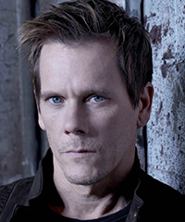
K E V I N B A C O N Golden Globe®-winning Actor, Producer, Director, Musician
Eight Wonders of the World.
Seven Continents on Earth.
Six Degrees of Kevin Bacon.
All of the GBTA Convention attendees gathered for lunch on Monday afternoon, which was followed by a keynote presentation by Kevin Bacon. The Golden Globe®-winning actor, producer, director, and musician shared a bit about what Six Degrees of Kevin Bacon is, and how it became the genesis of his philanthropic organization.
It all happened in 1994. Three guys were sitting around their college dorm room in Albright College in PA, watching a Kevin Bacon movie, and they came up with the game. Not long after, Howard Stern explained the game to Kevin Bacon himself.
“Let me explain something to you about actors,” Bacon says, “We crave attention. It’s a self-centered career path. There are two kinds of actors: actors who want to be famous, and liars.” So when he heard about this game, he was horrified. He thought he was the butt of a very complicated joke. “We live in fear that any success that we may have achieved has been some sort of freakish mistake, and that we will be found out to be the untalented, overpaid buffoons that we really are.”
As a guest on The Daily Show, Bacon finally got the chance to meet the three “knuckleheads” who originally conceived of the idea and found “they were disarmingly polite and respectful.” But pretty soon, “that little green bastard was sitting on my shoulder whispering about how to create something marketable out of it.” Six Degrees of Kevin Bacon was an idea, not something you could hold in your hands.
Then life happened. September 11th happened. Friends were lost to addiction and family members were diagnosed with cancer. Hungry children were living a stone’s throw from his apartment, and global warming was attacking the earth. Then one day: “I open up the refrigerator, and staring back at me from a jar of tomato sauce is Paul Newman.”
Bacon admired that Newman had combined his passion for good and his passion for food, so he began to seek to create something outside of himself, “that could combat the helplessness of this confusing and wonderful world.” Newman, he noticed, had never shied away from his celebrity.
So he called up a buddy and grabbed the sixdegrees.org domain, partnering with an organization called Network for Good to create a site where regular people could see the causes that celebrities were supporting, and then donate or volunteer for them. Except they found that, “while people are interested in what a celebrity cares about, they aren’t necessarily willing to support it with dollars and cents. The decisions people make with their charity dollars are very personal decisions. People give because they feel connection.”
So sixdegrees.org shifted direction and became an easy way for celebrities to connect with grassroots organizations that don’t have the benefit of large fundraising machines. Famous athletes, movie stars, and musicians can easily find “local unsung heroes who are trying to make a difference in their communities and therefore the world.” Then the opportunity is created. “Sixdegrees.org can facilitate an easy, painless, but satisfying drop-in at a local organization. A couple of pictures and a tweet or two helps show that people are grateful for what they do.”
As Bacon says, “the basic idea of the game is connectivity. That’s why I think this Six Degrees of Kevin Bacon thing has hung around. I think we’re all looking for connections. I encourage you to take me out of this game. It’s a really beautiful idea. Because we are all connected. And we have to remember that the things that we do on our block affect our neighbors down the street, but also around the world.
Maybe if we remember that, we’ll be more likely to take care of each other.”
Monday

Slide 16
The GBTA Convention 2015 Expo was packed with vendors, suppliers, and travel innovators. Here are the vendors and suppliers our company should follow up with:
Click here to list your supplier conversations or notes from the Expo Floor.
16

Slide 17
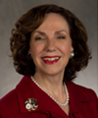
The Future of the
Travel Distribution Landscape Panel
Moderator
Dorothy Dowling SVP, Marketing & Sales
Best Western International
Douglas Anderson Chief Executive Officer Carlson Wagonlit Travel
David Pavelko Director, Travel Partnerships Google, Inc.
Scott V. Alvis
Chief Marketing Officer
Amadeus North America, Inc.
Tuesday kicked off with a discussion about distribution. New technology and an ever-changing consumer base is creating curveballs for travel sellers.
Data is Key. Combining information about revenue management and from CRMs allows distributors to target individual users and sectors, identifying trends and increasing the ability to offer good experiences.
Working Together Gets You Further. There is a heightened importance for vendors to work together and learn together in order to support the client.
Consumer Behavior Changes: Consumer behavior will continue to influence how the travel industry does business.
Listen Up. Consumers have demanded peer review capabilities, elaborate content needs, access to rates and inventories. When the consumer asks, successful companies listen.
Open Booking Will Gain Speed. Right now, there’s a 20/80 general split for open-booking versus non-open-booking companies. Mobile technology advances is going to even this number out. Bookings are becoming easier because of the demands being dictated by mobile users.
Tuesday
17

Slide 18
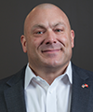
Ground Transportation in a Sharing Economy Panel
The GBTA has just released research on ground transportation based on a poll they distributed to travel managers They found that managed travel through the rental car is king, although Transportation Network Companies (TNC) are gaining ground. Taxis aren’t meeting expectations of travelers, and 71% of poll respondents say that have no set rules around processing and reimbursing TNC travel.
The Risks of Car Travel
Rose: The greatest risks for most of your travelers using taxi cabs will be corporate credit card fraud, or pickpocketing because they’ve dug their money out to pay the fare. Many companies don’t want single travelers standing around at night trying to find a taxi. Additionally, there is no knowledge about what the travelers are doing. There is no way to aggregate the data around taxis.
Seelinger: Why would you accept the service of a company that doesn’t consent to random drug testing over one that does?
The Benefits of Technology Rose: Now, you’ll be able to manage all the ground transportation risk because the data is there. It’s real-time data, and for us, we can get the data immediately. Everyone here has traveler tracking, but when your passenger has landed in Berlin, how do you know if they’ve boarded a train to Frankfurt already? The technology creates an opportunity to lower risk.
Seelinger: Our industry will soon come out with something very similar (to the Uber app) in order to compete with it.
Solombrino: What do you do to compete in this environment? Cordial relationships amongst major corporations in ground solutions have helped us create something new we can bring to market to enable us to compete.
An Unfair Advantage
Solombrino: There is not a level playing field on the regulatory front in the marketplaces. TNCs will surpass the entire 9 billion dollar taxi and 3 billion dollar black car/limo industry combined, but they don’t face the same regulations demanded by the industry for those companies.
Seelinger: When you come into a market and completely disregard any local ordinances or state laws…. I have to follow particular guidelines for particular states. But the TNCs do not. We’re just looking for a level playing field. These companies are operating as independent contractors, instead of as small businesses. They are avoiding unions and basic employee rights, like healthcare provision and overtime pay. They should be required to treat their people properly. It costs each of us 40% more to operate than each of them.
Moderator
Mike McCormick Executive Director & COO GBTA
Scott Solombrino
President and CEO
Dav El/Boston Coach Chauffeured Transportation Network
Tuesday
David Seelinger Chairman and CEO EmpireCLS Worldwide Chauffeured Services
John Rose Chief Operating Officer iJET International, Inc
18

Slide 19
Ground Transportation in a Sharing Economy Panel
The Risks of TNC Travel
Seelinger: What are your policies and procedures? Are you actually operating legally in these areas, or is your business reputation on the line?
Solombrino: For a travel professional, they will have to think to themselves: “If I endorse this, I have to make sure that they’re adhering to local law, state law, subjecting themselves to random drug testing.” Taxi drivers in the U.S. are the most highly-regulated sector in the transportation industry, other than airline pilots.
Rose: Taxis around the world are unregulated; In the U.S. and Western Europe, your biggest concern in a taxi is credit card fraud and pick-pocketing, but across the globe, there are not comparable restrictions in the taxi industry.
Tuesday
The Takeaway
Transportation Network Communities (TNCs) do not face the same regulations as taxi and black-car companies.
The major risks for taxi travel in the U.S. and Western Europe are credit card fraud and pickpocketing.
TNCs offer data and tracking that taxis do not. This is better for risk management and data management.
Ground Solutions companies may soon release similar technology to the innovative Uber app in order to better compete.
Examine insurance policies and security restrictions before considering writing TNCs into your policy.
19

Slide 20
Over 80 elective education sessions were offered over the course of the week, allowing attendees to explore specific topics within the travel industry.
Third Education Session Notes:
Click inside this text box and insert any notes you took on your third education session.
Tuesday
Fourth Education Session Notes:
Click inside this text box and insert any notes you took on your fourth education session.
Workshop 2 Notes:
20

Slide 21
#Sharing 101 - Actionable Guidance for Corporate Travel Managers
Mark McCabe
Business Travel Lead, Airbnb
In this session, Mark McCabe of Airbnb provided insight into how the sharing economy works, why it works, and how Airbnb may gain popularity among business travelers.
Sharing Economy
Also known as the On-Demand Economy, Collaborative Consumption, or Peer-to-Peer Economy, the Sharing Economy has really only hit the mainstream in the last 12 months. It is predicated on a few key tenants:
A direct relationship between the buyer and seller (through an online conduit)
Reusing untapped resources and assets
Technology-enabled (for payments, reviews, and scalability)
Reputation and Reviews (to qualify and select who to buy and sell with; once you depended upon a brand to determine the quality of your product; now you depend on the reviews of others. McCabe makes the analogy of this being similar to “Ask the Audience” on Who Wants to be a Millionaire, which is statistically more reliable than “Phone a Friend.”
The Sharing Economy is impacting all sorts of industries, including transportation, professional services, personal services, leisure, and more. 17 Sharing Economy companies are valued at over 1 billion dollars, and over 15 billion dollars of investment have gone into the Sharing Economy. Everything about the business is tracked, from user growth to engagement, in order to create sustainable business practices.
Access vs. Ownership
McCabe posits that several things account for the Share Economy boom, and the transition of popular consumption philosophy.
Economics: Economic situations around the world have change peoples’ attitudes toward consumption.
Experiences: People are beginning to place more value on experiences gained in life than on the things owned.
Independence: There is an increasing desire to self-manage and not be reliant on others.
Hatred of Waste: New generations recognize effects on environment
Technology: New developments are enabling new and innovative commerce.
The Internet
The first generation of internet companies simply moved what was available in brick-and-mortar to also be available via the internet. But now, “companies are reinventing how we interact with each other and how we manage goods and services.” Intermediaries are being eliminated, and direct person-to-person consumption is becoming more prevalent. Airbnb
“I’ll do my best not to sell it too much,” says McCabe, as he begins to explain how Airbnb is navigating these market shifts. The company started when its founders needed to pay rent. They had $700 in the bank and needed $1100 to make rent.
Tuesday
21

Slide 22
“They had a math problem.” So they rented their apartment to some designers in town for a conference, and showed them around the city. That’s how Airbnb began. Now they have over 1.5 million listings in over 34,000 cities worldwide.
Government Relations
In one year, Airbnb contributed an estimated $240 million to the Parisian economy by distributing tourism dollars across diverse neighborhoods. “70% of Airbnb properties are located outside the main hotel districts in Paris.” Governments are recognizing the possible benefits of harnessing these travel dollars, and are beginning to address problems issues like regulations and implementing hospitality taxes on Airbnb renters. Airbnb works with cities to make sure that hosts are compliant and they pay occupancy tax if they’re permitted to.
Business Travel and the Sharing Economy
Ralph Colunga, Senior Director of Travel for Concur, was the impetus for creating a business interaction for Airbnb. “We have no visibility into what’s going on with our employees on Airbnb, so we can’t promot you,” he said. They then worked out a way to approach this problem, creating an interface through TripLink that allows Airbnb rentals to be recorded, tracked and expensed through Concur.
Business Travelers and the Sharing Economy
When a business trip extends beyond a few days, Airbnb argues that there are major amenities that can be gained by staying in a home instead of a hotel. Travelers can wash their clothes and prepare their own dinners. They can feel “at home” or a little more comfortable while on the road. And they can interact with the local culture more easily.
Travel Manager Concerns
Airbnb is beginning to listen to travel manager concerns and questions about their product.
Technology - Airbnb features a beautiful interface that incorporates reviews and ratings, and is mobile-friendly.
Duty of Care/Risk Management - Airbnb has just released dashboards for duty of care tracking that can be incorporated with International SOS data. Additionally, Airbnb has two different insurance coverage programs: one is for damage to the property, and one is for the traveler’s insurance.
Cost Savings/Compliance - Dashboards give full visibility into spend, and integration with Concur allows tracking of what’s being booked and whether or not it’s saving money. McCabe says that staying at an Airbnb saves an average of 37%, and that the average stay in an Airbnb is twice as long as hotel stays.
Employee Experience - As Airbnb begins to accrue feedback from corporations, they find that users are very satisfied with the experience. Whether or not it’s caused by mitigated expectations, certain studies say that travelers rate Airbnb stays at 4.72 stars, versus 4.04 stars for hotel stays.
The Details
McCabe fielded a wide variety of questions. Here’s the takeaway:
Airbnb integrates with Concur TripLink. Itineraries are sent to Concur Travel, receipts to Concur Expense.
Properties may be personally vetted by an Airbnb team member, but probably not. Airbnb monitors product quality through assessing the renter, and then through peer reviews. They provide a transparent review process.
They are actively looking at expanding into other corporate travel ecosystems, but currently can work with Concur and International SOS
Airbnb is especially popular with travelers looking for 6-7 night stays
Hosts price themselves; there are no supplier agreements or negotiable rates, although Airbnb may, in future, look at discounting the Airbnb management/service fee. Currently, low rates allow an average of estimated 25-50% savings over other lodging options.
There is currently no loyalty program for Airbnb. Although it may be something they develop in the future, McCabe says, “People are using us for different reasons than when they book other hospitality locations. It’s not as important for us to incentivize.”
Hosts set the check in/ check out time.
Airbnb’s Hospitality Team provide hosts with pointers on how to become “superhosts”.
The average age of an Airbnb guest is 36 years old.
Tuesday
22

Slide 23
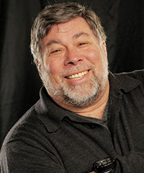
S T E V E W O Z N I A K Designer, Inventor, and Visionary
Genius to the Macs
Interviewed by: Nina Easton; Fortune Magazine
Made Possible by:
Steve Wozniak - or Woz, as he likes to be called - has always had the desire to make a difference. From a very young age he watched his father, an electrical engineer at Lockheed, work on important designs for amazing machines. And young Woz thought, “I want to be that important to the world.”
“I thought, ‘What do engineers do? They make all the things people didn’t have before. Let’s make the world greater, and easier. And someday you’ll only have to work four days a week!”
As the only one of three siblings who became an engineer (“I was good at math,”) Woz was a self-described “geeky kid” in his neighborhood. His adolescent friendship with Steve Jobs was an odd-couple pairing. “Steve was more like a real hippie. I enjoyed hanging out with real hippies but I could never be one of them. Steve walked around with bare feet. I had a job. I was so advanced, I didn’t need to worry about an income.”
Woz and Jobs struck up an unlikely friendship, discussing philosophies and world religions but never really setting out a particular plan to revolutionize the computer industry. “He knew I could design anything, but we didn’t really sit down and discuss that sort of thing.”
As a designer, Woz was intrigued by the possibilities in a computer. “The hardest part was input/output. How does a human being input things into a computer, and how do they get them out? I had zero money, and this had never been done before, so I had to use my own brain to figure them out.”
That’s Woz’s secret, how he says he got to be good: finding a problem that hadn’t even been conceived before, and using his own faculties to figure it out. “I don’t have any guidance,” he says, when asked for advice in entrepreneurship and invention. “I wanted a computer. So when I saw the formula to build a good one that was affordable and fun, I was gonna build it whether it was worth anything or not.”
Tuesday
The world has changed so much. Our whole industry had sprung out of young people getting together in clubs and sharing information.
In regards to travel, Woz benefited from his own contributions to technology. “I used to be my own travel agent. I had the paper flight guides.” He would examine the flight schedules and determine the best way to get from point A to point B on his own. But soon, there were computer programs to do that sort of thing. “Once a travel agent was able to use a computer to figure out my travel faster than I could do it on paper, I let it go.”
Woz then made a comment that many thought was a joke, but he meant completely honestly: “Travel makes you learn yourself. If one person travels once a year, they’re an expert on travel.” It’s not surprising that the inventor of the personal computer sees the personal aspect of travel, despite the prevalent cynicism of the industry. Although he certainly recognizes the importance of business travel. “You’ve got to globalize. Socialization is very important. The socialization aspect of business travel is going to continue, as well as pleasure and entertainment, as long as we can afford it.”
After sharing that he recently traveled to Germany for the Segway Polo Championships, Woz highlights the importance of conveniences and personalization in the travel industry. He recognizes some innovations. “Why am I giving my license and credit card, and the hotel clerk is typing it into a computer? Check in with SPG and you have your room key sent right to your phone.” And, unsurprisingly, “I want to travel on the Quantum of the Seas one day. It’s a cruise ship that has 600 megahertz of bandwidth.”
His final comment? “TSA Pre changed my attitude toward the TSA, because I can actually smile at them now.”

Slide 24
Over 80 elective education sessions were offered over the course of the week, allowing attendees to explore specific topics within the travel industry.
Fifth Education Session Notes:
Click inside this text box and insert any notes you took on your fifth education session.
Wednesday
24

Slide 25
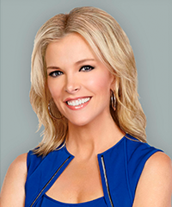
M E G Y N K E L L Y Anchor of FOX News Channel's (FNC) The Kelly File
Interviewed by: Michael McCormick, GBTA
The Blonde Who Drops Bombshells
“What am I doing here with you? It’s a combination of guilt and penance.”
Kelly launched into her Keynote session with a joke. “On behalf of women with children everywhere, I’m here to apologize.” She proceeded to tell the story of a post-Presidential debate trip home from Iowa, featuring her infant daughter and an epic diaper blowout. The recounting culminated in her realization that the change of clothes she had picked up from a Minneapolis airport gift shop declared, “Rock n’ Roll Cowgirl” and “Screw it. Let’s ride!”
Then the levity faded, as Kelly began to talk, “a little bit about myself, and a little about the news.” She shared personal experiences and tied them to what we see in the headlines today.
Kelly shared that she was bullied as a child, with the aside, “In comparison to those 276 girls kidnapped by Boko Haram, I hesitate to mention this….” But her 7th grade experience of bullying was very real, and she learned two things: She vowed never to be hurt by a bully again, and she learned one friend is all you need.
“There are bullies everywhere,” she transitioned. “By far the worst bully of all is the media, because of their power.” Kelly spotlights the media coverage of Ferguson, MO, and the release of the DOJ report that found, contrary to media suppositions, that Michael Brown was indeed advancing on Darren Wilson, who fired in self-defense. “And the media’s silence in the wake of the DOJ report was deafening.”
The next experience Kelly shared was deeply personal, the death of her 45-year-old-father when she was just 15. “There we were with the Christmas tree up, and without a father and a husband. It made me be more conscious of my own mortality. It’s a gift, not a curse. “I feel strongly that life is too short to put up with BS.”
Currently prepping for the first debate among Republican Presidential Candidates for 2016, when promises, “I will be there to protect no one on that stage, but to protect my viewers.” Campaign spokesmen, she says, “have no adult relationship with the truth. Spokespeople sound like Stepford aids.”
Tied to this, she recognizes that it all hangs by a thread. “Everyone in public life is one step away from being tagged for ruination.”
Experience number three was her career change. Kelly practiced law in Chicago for nine years, by which time she was missing vacations, weekends, weddings, and funerals. Driving home one morning at 3am, she caught herself considering, “What if I just had a car accident where I broke a bone? Not my spine… just a bone… like a femur.”
Her personal realization was: “Just because you’re good at something doesn’t mean it makes you happy.”
This dire night precipitated her move to broadcasting (with a little networking and some hard work to get there), but she now brings her law-practice skills to the news desk. “I learned how to make information into digestible bits, to not take things at face-value; to question the too-convenient narrative.”
Wednesday
I am more interesting than this. I am more interested than this.
“I’m an Independent; For me, it’s easy to press both sides.”
“Be yourself. Trust me, it’s not that easy.”
“While I love my news career, it does not define me as a person or a woman. I am Megyn Kelly: a wife, a mother, a friend, a daughter. I happen to be a newscaster as well.”
Quotes from Megyn
25

Slide 26
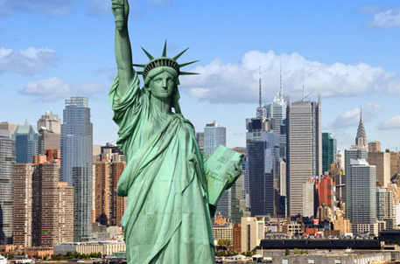
NEW Performance Analytics
One of our newest WorldReports™, the Performance Analytics Dashboard allows you to benchmark against self-set goals for policy metrics, including online adoption, advance purchases, hotel partner use, and ticket exchanges. Use this visual display of compliance to analyze compliance by department or cost center, and track policy compliance trends.
eGlobal Fares Global travel means global content and availability. This newly implemented tool allows World Travel, Inc. to get the best available pricing. Contact your account manager to learn more.
Pro: Multi-GDS functionality and integration
Pro: Low cost carrier/web look-and-book
Pro: Multi-leg itinerary search capability
Con: POS restrictions on tariff rules
Con: Changes to non-USA POS reservations could take longer
Con: Currency fluctuations, credit card limitations and restrictions
Coming Soon
2015 Fall Symposium and Trade Show
October 16, 2015
New York City
It’s coming! Fall Symposium returns to the Big Apple. This bi-annual event grows every year, so mark your calendar now. It’s a perfect time to meet the World Travel, Inc. team, interact with other travel professionals, and learn about what’s going on in the travel industry. Our trade show floor is the perfect place to ask questions of current and prospective suppliers.
26

